Slide 1
Il fisco: leva di crescita economica per uno sviluppo sostenibile
OVERVIEW DELLE ESPERIENZE DI FISCALITA’ E CRESCITA ECONOMICA DI ALTRI PAESI
Roberta Grappiolo
European Commission
DG TAXUD.D3
Direct taxation and State aid

Slide 2
Making it happen
Growth Taxation
EUROPA 2020 -COM(2010) 2020 of 3.3.2010
'smart, sustainable and inclusive economy'
Investments and employment friendly
Efficient
Fair
European Semester
EU's yearly cycle of economic and budgetary coordination

Slide 3
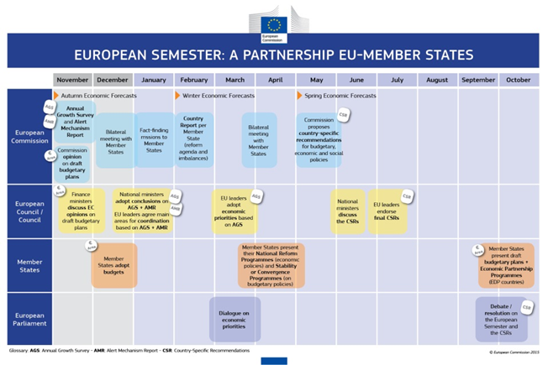

Slide 4
European Semester 2015
Annual Growth Survey (Autumn forecast 2014)
1.boosting investment 2.accelerating structural reforms 3.pursuing responsible, growth-friendly fiscal consolidation
Country Reports /MIP [26.2.2015 COM(2015) 85 final]
STAFF WORKING DOCUMENT (Spring Forecast 2015)
Bilateral + National Reform Programs (April 2015)
CSR 2015

Slide 5
EU Semester 2015 TAX Policy Priorities
Pursue tax shift away from labour;
Design tax systems conducive to productive investments;
Simplify tax systems and broaden tax bases;
Deliver a fair tax system by fighting tax fraud, evasion and avoidance.

Slide 6
EU Semester ITALY CSR2/2014 on taxation
trasferire ulteriormente il carico fiscale dai fattori produttivi ai consumi, ai beni immobili e all’ambiente;…riesaminare la portata delle agevolazioni fiscali dirette e allargare la base imponibile…sui consumi;
garantire una più efficace imposizione ambientale, anche nel settore delle accise, ed eliminare le sovvenzioni dannose per l’ambiente;
attuare la legge delega di riforma fiscale entro marzo 2015, in particolare … i decreti che riformano il sistema catastale;
sviluppare ulteriormente il rispetto degli obblighi tributari,… semplificando le procedure …e modernizzando l'amministrazione fiscale;
perseverare nella lotta all'evasione fiscale e adottare misure per contrastare l'economia sommersa e il lavoro irregolare;

Slide 7
Italian growth–friendly tax measures
Labour costs deductibility from IRAP
ACE
R&D Tax credit
Start-up tax credit
Reverse charge and split payment
Simplification (pre-filled declaration, e-invoicing)
Tax compliance (VDP)
Tax gap yearly report
Companies' internationalization

Slide 8
ITALY 18.3.2015 SWD(2015) 31 final/2

Slide 9
EU Semester CSR2015 of 13.5.2015
Implement the enabling law for tax reform by September 2015, in particular the revision of tax expenditures and cadastral values and the measures to enhance tax compliance.

Slide 10
Steps forward…
Transparency package of 18.3.2015 COM(2015)135 final
Comm proposal for automatic exchange of information
between MS on tax rulings.
Action Plan on competitiveness taxation
Long term holistic solutions (CCCTB)
Tailored EU solutions
Transfer prices rules
Arbitration mechanism

Slide 11
Tax Reforms in EU member States 2014
"Member States' ongoing efforts to consolidate, improve the quality of public finances and to foster sustainable economic growth and employment mean that tax issues are likely to be a key issue for the foreseeable future".
M. Buti (DG ECFIN) H. Zourek (DG TAXUD)

Slide 12
Useful links
EUROPA 2020:
http://ec.europa.eu/europe2020/europe-2020-in-a-nutshell/index_it.htm
AGS 2015
http://ec.europa.eu/europe2020/pdf/2015/ags2015_en.pdf
Country reports 2015 http://ec.europa.eu/europe2020/pdf/csr2015/cr2015_italy_en.pdf
Tax reforms in EU Member States 2014: http://ec.europa.eu/taxation_customs/resources/documents
NRP 2015-2017
http://www.dt.tesoro.it
Transparency
http://ec.europa.eu/taxation_customs/taxation/company_tax/transparency/index_en.htm

Slide 13
Thank you!
roberta.grappiolo@ec.europa.eu

Slide 14
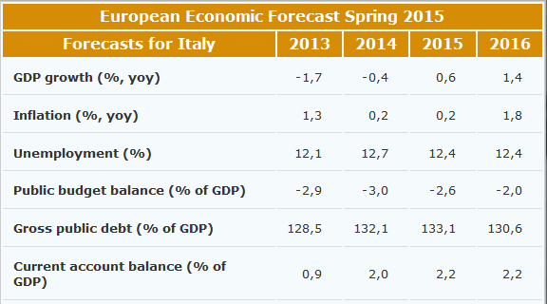

Slide 15
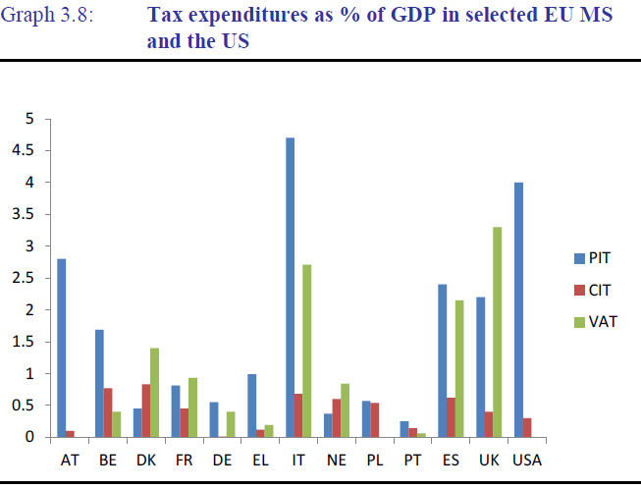
Source: OECD (2010a).

Slide 16
Action Plan 2015
Announced in Commission Work Plan 2015
"in the light of global developments the Commission will present an Action Plan on a renewed approach for corporate taxation in the Single Market, where profits are taxed where the value is generated"

Slide 17
Commission Action: 18.3.2015 Exchange of information on tax rulings
Which rulings?
Broad scope on taxes, taxpayers covered and type of rulings
Retrospective element – 10 years back
Which information?
Push: pre-defined information
Pull: Member States can ask for more if relevant to them
How often?
Automatic exchange every 3 months
To whom?
All other Member States (Elimination of discretion) and the EC
When?
Effective date of implementation 1/1/2016

